Slide 1
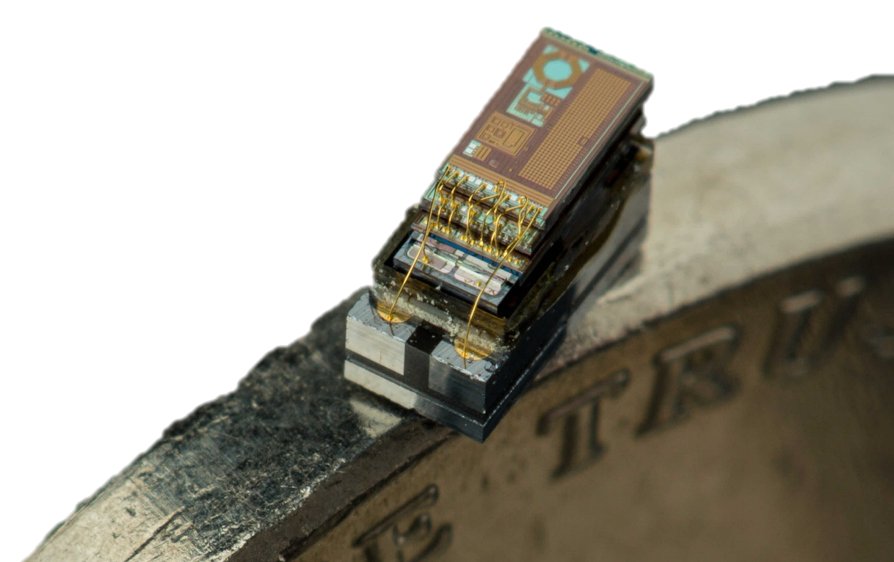
Lessons From Five Years of Making Michigan Micro Motes (M³)
Pat Pannuto, Yoonmyung Lee, ZhiYoong Foo, Gyouho Kim, David Blaauw, and Prabal Dutta
University of Michigan
6th Workshop on Architectural Research Prototyping (WARP ‘15)
June 14, Portland, Oregon, USA

Slide 2
Behind the scenes on what was required to realize an ecosystem of mm-scale computers
On display now at the computer history museum

Slide 3


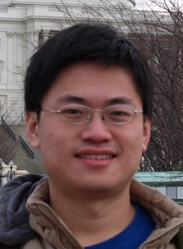
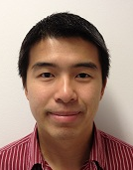
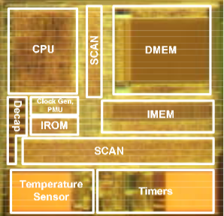


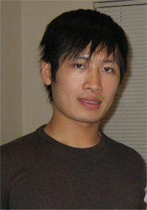


2008: The Phoenix Processor
World’s lowest power computer
Set records for volume and energy
And could be used by at best the grad students that built it
Mingoo Seok
Scott Hanson
Yu-Shiang Lin
ZhiYoong Foo
Daeyeon Kim
Yoonmyung Lee
Nurrachman Liu
Dennis Sylvester
David Blaauw
The Phoenix Processor: A 30pW Platform for Sensor Applications, M. Seok, VLSI ‘08
Notes:
Phoenix: Mingoo Seok, Scott Hanson, Yu-Shiang Lin, Zhiyoong Foo, Daeyeon Kim, Yoonmyung Lee, Nurrachman Liu, Dennis Sylvester, David Blaauw
IOP: Gregory Chen, Hassan Ghaed, Razi-ul Haque, Michael Wieckowski, Yejoong Kim, Gyouho Kim, David Fick, Daeyeon Kim, Mingoo Seok, Kensall Wise, David Blaauw, Dennis Sylvester

Slide 4
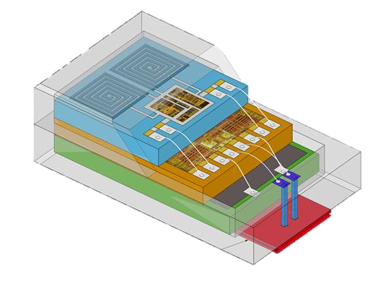
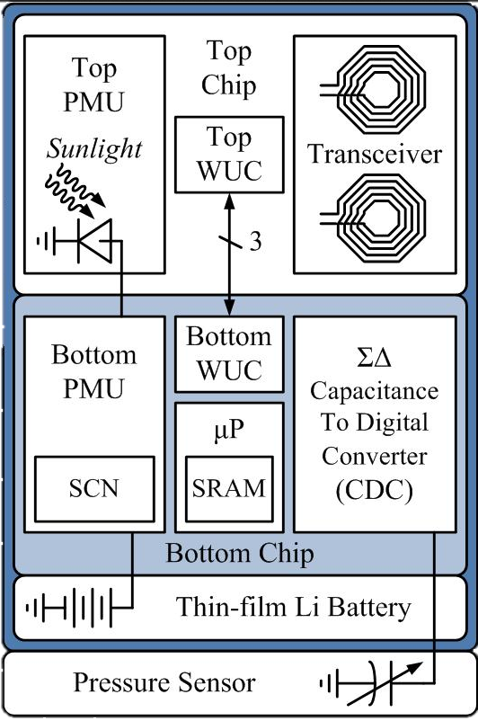
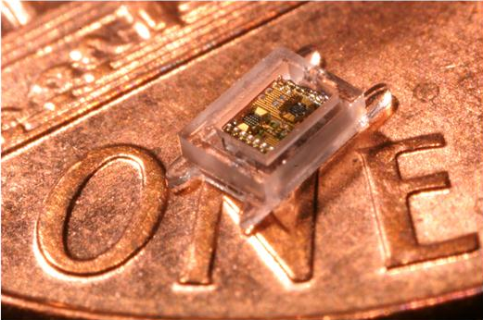
From temperature sensor to pressure sensor: 3 Years.
0.7 mm
2 mm
1.2 mm
Motivating application for mm-scale sensor: Intraocular pressure
Critical diagnostic tool for glaucoma
A Cubic-Millimeter Energy-Autonomous Wireless Intraocular Pressure Monitor, G. Chen, ISSCC ‘11
Notes:
http://blaauw.eecs.umich.edu/getFile.php?id=434&sid=vomuvflatyhha
IoP – 1.2 mm wide, 2 mm long, 0.7 mm high, 0.35 mm high battery

Slide 5
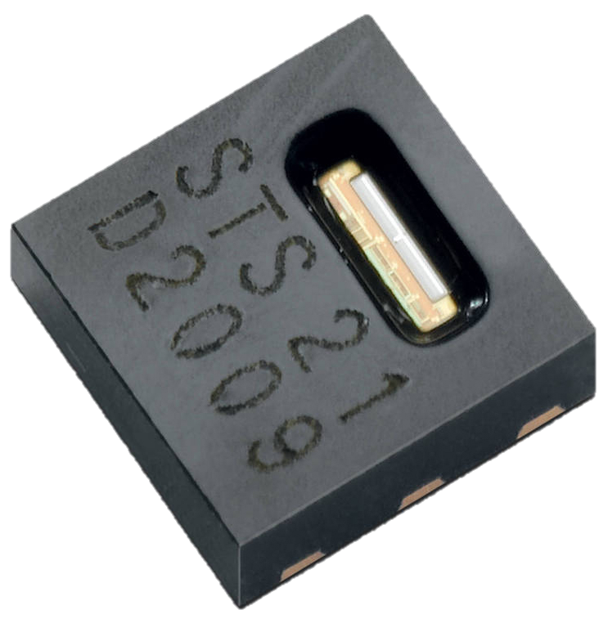
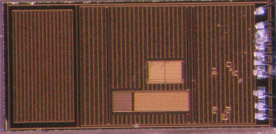
What’s wrong with this picture: “How to build a wireless temperature sensor?”
cm-scale
mm-scale
Step 1: Buy a low-power temperature sensor
Step 1: Design a low-power temperature sensor
~10 pW standby, < 1 µW active

Slide 6
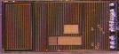

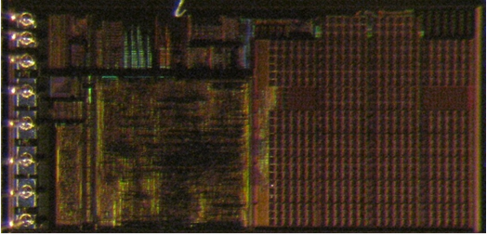
What’s wrong with this picture: “How to build a wireless temperature sensor?”
cm-scale
mm-scale
Step 1: Buy a low-power temperature sensor
Step 2: Buy a low-power microcontroller
Step 1: Design a mm-scale temperature sensor
Step 2: Design a mm-scale CPU
~10 pW standby, < 1 µW active

Slide 7
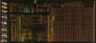

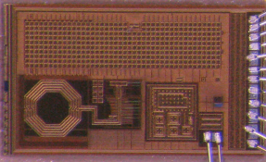

What’s wrong with this picture: “How to build a wireless temperature sensor?”
cm-scale
mm-scale
Step 1: Buy a low-power temperature sensor
Step 2: Buy a low-power microcontroller
Step 3: Add low-power communications
Step 1: Design a mm-scale temperature sensor
Step 2: Design a mm-scale CPU
Step 3: Design a mm-scale radio
~10 pW standby, ~5 µW active

Slide 8
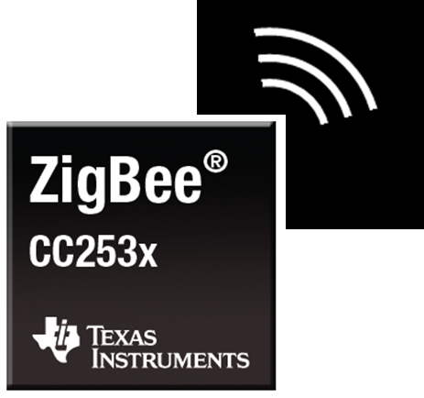
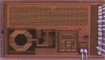

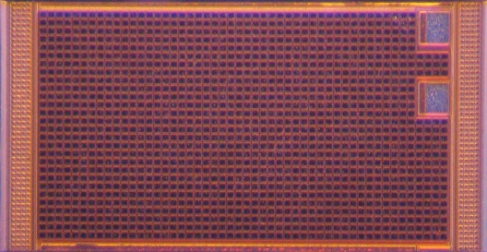
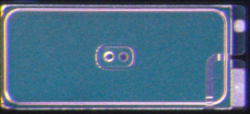
What’s wrong with this picture: “How to build a wireless temperature sensor?”
cm-scale
mm-scale
Step 1: Buy a low-power temperature sensor
Step 2: Buy a low-power microcontroller
Step 3: Add low-power communications
Step 4: Add a power supply
Step 1: Design a mm-scale temperature sensor
Step 2: Design a mm-scale CPU
Step 3: Design a mm-scale radio
Step 4: Add power supply and storage
Energy Harvesting
Energy Storage

Slide 9
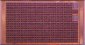

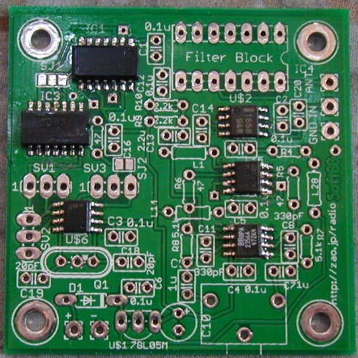
What’s wrong with this picture: “How to build a wireless temperature sensor?”
cm-scale
mm-scale
Step 1: Buy a low-power temperature sensor
Step 2: Buy a low-power microcontroller
Step 3: Add low-power communications
Step 4: Add a power supply
Step 5: Integrate the chips
Step 1: Design a mm-scale temperature sensor
Step 2: Design a mm-scale CPU
Step 3: Design a mm-scale radio
Step 4: Add power supply and storage
Step 5: Integrate the modules

Slide 10
What’s wrong with this picture: “How to build a wireless temperature sensor?”
cm-scale – Modular System
mm-scale – Monolithic System
Step 1: Buy a low-power temperature sensor
Step 2: Buy a low-power microcontroller
Step 3: Add low-power communications
Step 4: Add a power supply
Step 5: Integrate the chips
Step 1: Design a mm-scale temperature sensor
Step 2: Design a mm-scale CPU
Step 3: Design a mm-scale radio
Step 4: Add power supply and storage
Step 5: Integrate the modules

Slide 11
What’s wrong with this picture: “How to build a wireless temperature sensor?”
cm-scale – Modular System
mm-scale – Monolithic System
Integrate components using well-defined, standard interfaces
SPI
UART
I²C
Integrate components using Verilog
temp_sense t1 (
…
.sample_valid_out (to_proc_t1_sample_valid),
.sample_out (to_proc_t1_sample),
);
processor p1 (
…
.temp_valid_in (to_proc_t1_sample_valid),
.temp_in (to_proc_t1_sample),
What’s different?

Slide 12

What’s wrong with this picture: “How to build a wireless temperature sensor?”
cm-scale – Modular System
mm-scale – Monolithic System
Integrate components using well-defined, standard interfaces
SPI
UART
I²C
Previously unseen constraints on volume and energy

Slide 13
What’s wrong with this picture: “How to build a wireless temperature sensor?”
cm-scale – Modular System
mm-scale – Monolithic System
Integrate components using well-defined, standard interfaces
SPI
UART
I²C
Previously unseen constraints on volume and energy

Slide 14
What’s wrong with this picture: “How to build a wireless temperature sensor?”
cm-scale – Modular System
mm-scale – “Modular” Systems
Integrate components using well-defined, standard interfaces
SPI
UART
I²C
Ad-hoc composition results in poor use of volumetric space

Slide 15
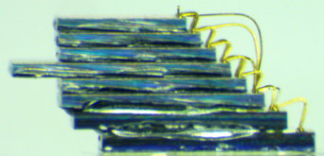
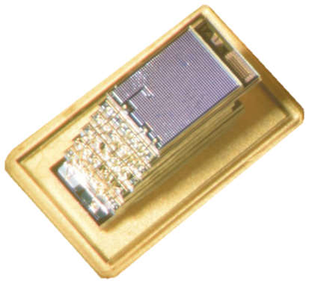
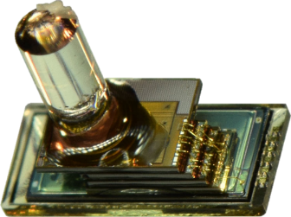
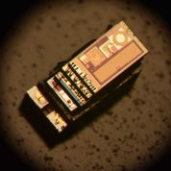
MBus, the missing interconnect that enables the mm-scale computing class
22.6 pJ / bit / chip, < 10 pW standby / chip
Single-ended (push-pull) logic
Low, fixed wire count (4)
Multi-master
Power-aware
Implemented in over a dozen (and growing) mm-scale chips
CPU, Radio
Flash Memory
Temperature, Pressure, Imager
To make half a dozen (and growing) mm-scale systems

Slide 16
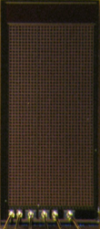
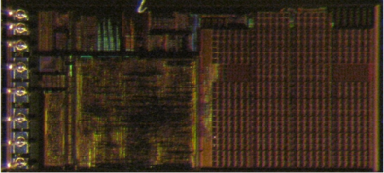
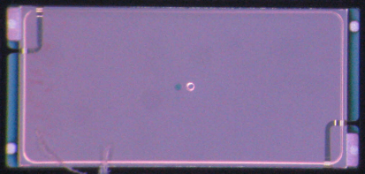

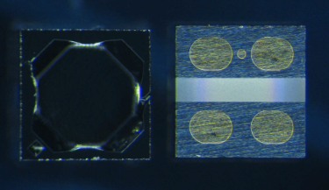
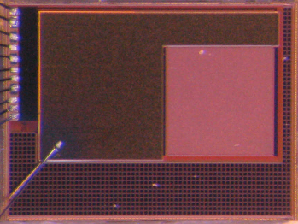
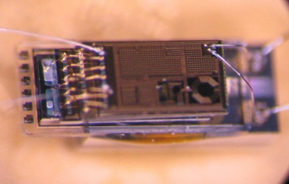
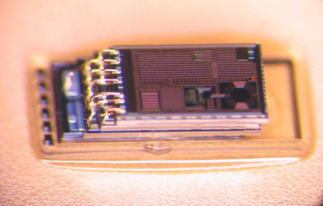
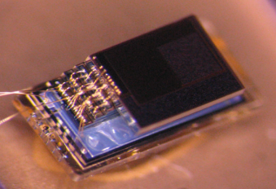
MBus enabled modular components, key to the rapid development cycle we now enjoy
From temperature sensor to pressure sensor:
3 months.
Control/
PMU
Decap
Temp Sensor
Radio
+ CDC
2 uAh Battery
5 uAh Battery
MEMS
P. Sensor
Motion Detection/ Imager
Pressure Sensing
Temp. Sensing
Visual Sensing
Notes:
Modularity is one of the most important things in arch; when useful integrate. Currently mm-scale systems prematurely integrate due to artificial constraints

Slide 17
Learn more about MBus at ISCA
Session 10B
MBus: An Ultra-Low Power Interconnect Bus for Next Generation Nanopower Systems
Wednesday, 13:50 in Oregon 204

Slide 18
Digging into what a mm-scale system looks like and why that really matters
Flashy pictures from a good camera can be misleading.
In practice, several nodes fit on a period

Slide 19
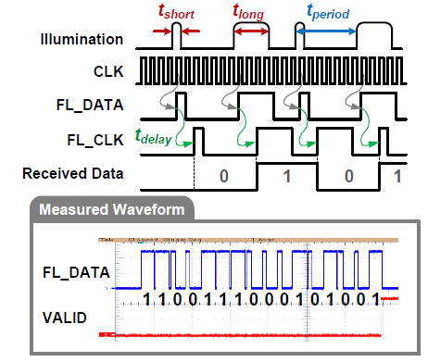
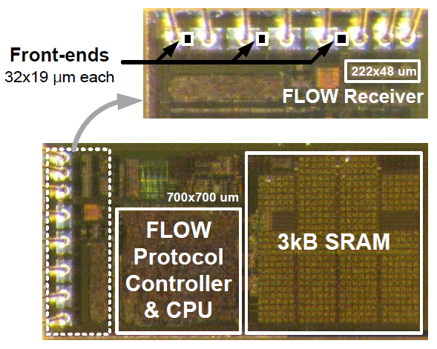
How do you bootstrap (program) a node that’s too small to attach wires to?
Visible light communications
Gyouho Kim, Yoonmyung Lee, Suyoung Bang, Inhee Lee, Yejonng Kim, Dennis Sylvester, David Blaauw, “A 695 pW Standby Power Optical Wake-up Receiver for Wireless Sensor Nodes,” IEEE Custom Integrated Circuits Conference (CICC), September 2012
Notes:
Orally mention other fresh-of-the-line issues, e.g. when the battery is connected

Slide 20
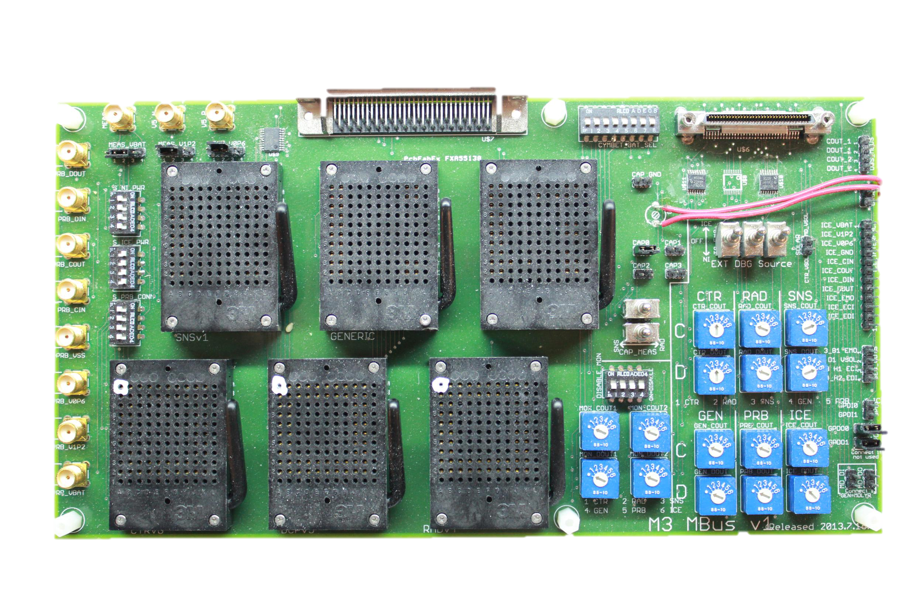
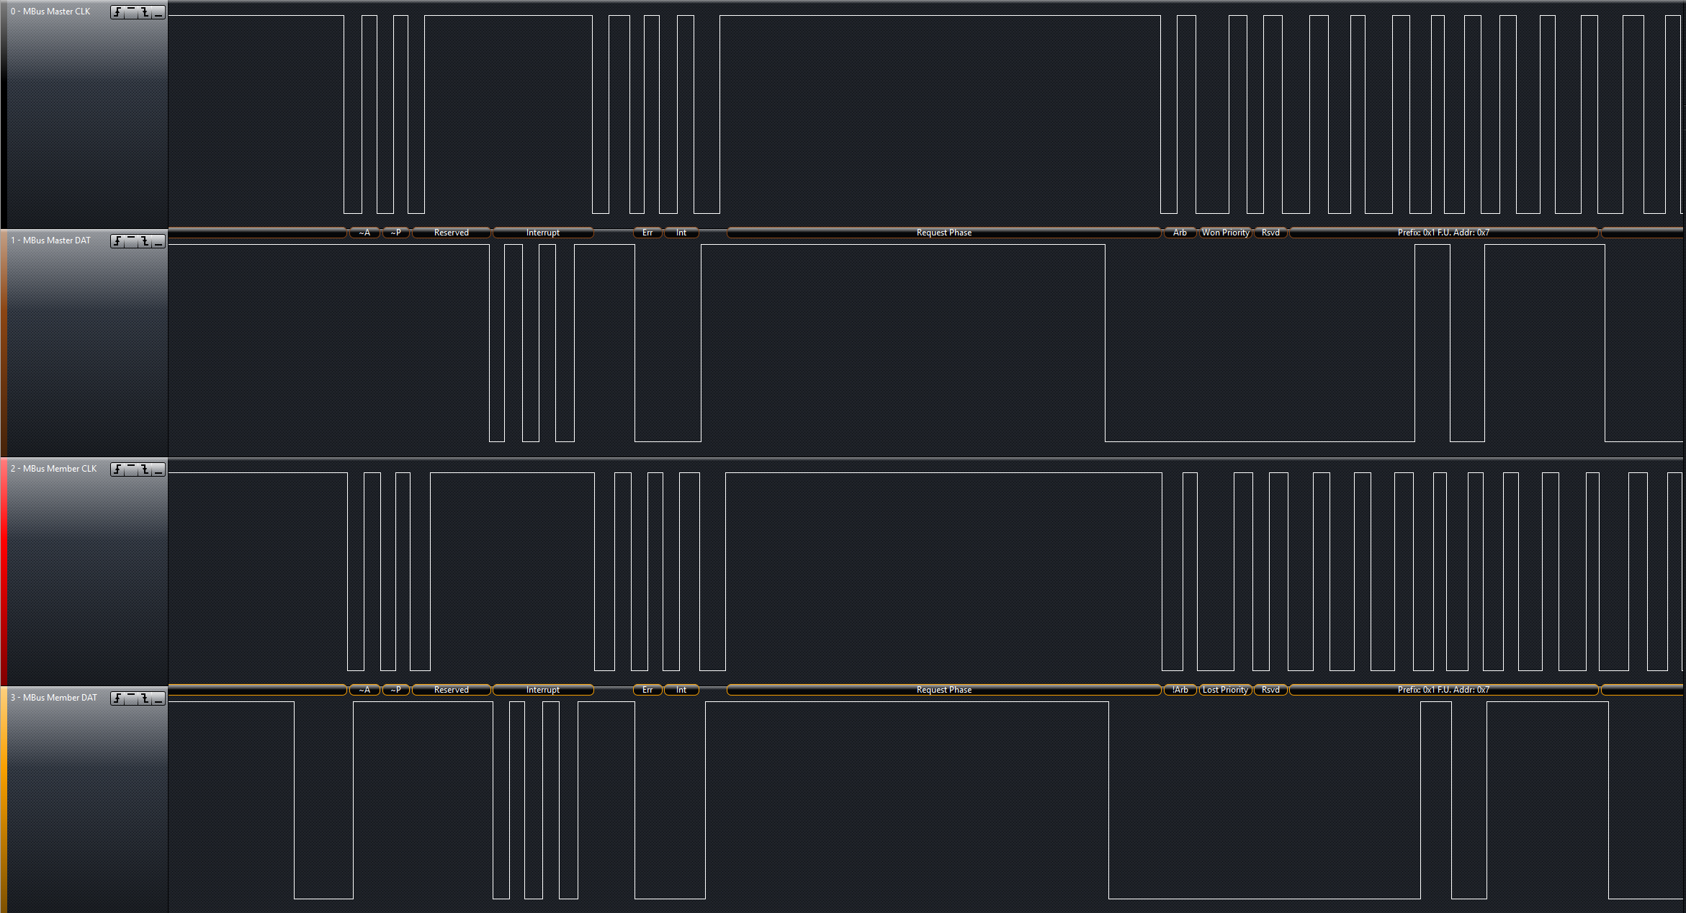
Open Q: How do you debug a node that’s too small to attach wires to?
Partial answers
Breakout system
Visible light debugging
Inject arbitrary messages
Power trace debugging
Each state has a power signature
Bus snooping
Plug-in for Saleae logic analyzer
Big Open Q: Postmortem

Slide 21
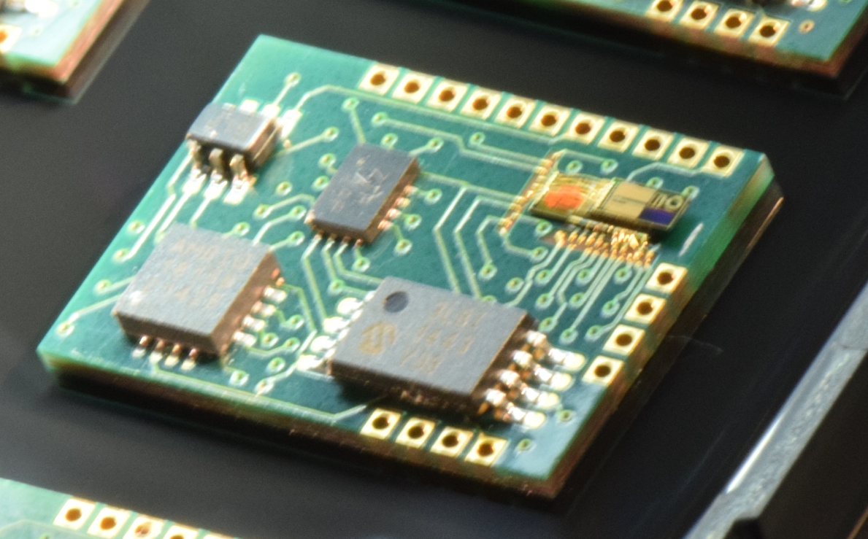
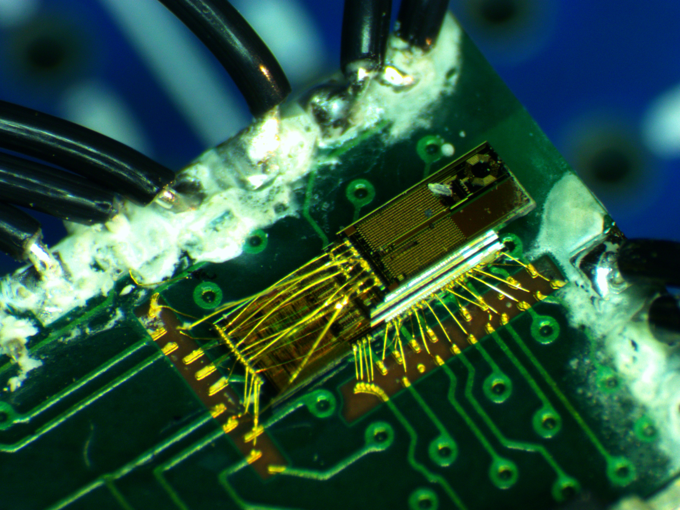
[Recent efforts] How do you solder a node that’s too small to attach wires to?
Integrating mm-scale chips with COTS chips
Recent issues: Metals for both soldering and wirebonding
(to 50 μm pads)

Slide 22
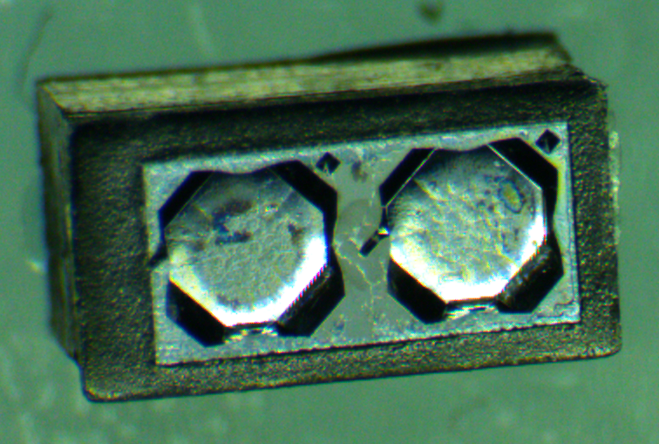
Re-discovering packaging problems from the MEMS community
Bio-compatible pressure sensor
Can seal electronics in bio-compatible epoxy
How to expose the pressure sensor?

Slide 23
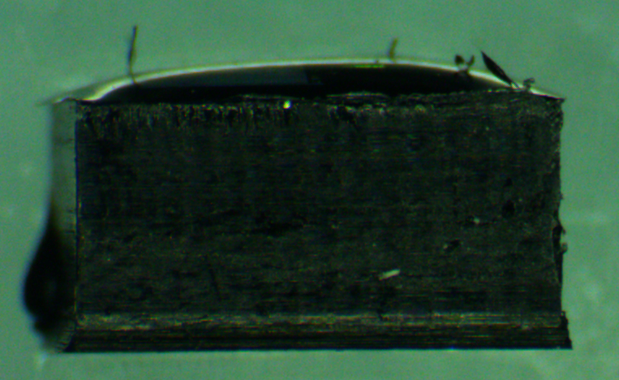
And adding some new packaging problems of our own
Bio-compatible pressure sensor
Can seal electronics in bio-compatible epoxy
How to expose the pressure sensor?
Some of the electronics are light sensitive

Slide 24
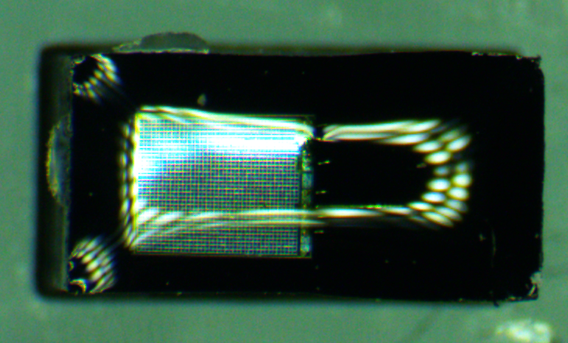
Systems considerations fit into the packaging puzzle too
Bio-compatible pressure sensor
Can seal electronics in bio-compatible epoxy
How to expose the pressure sensor?
Some of the electronics are light sensitive
The node relies on solar (or IR) harvesting to charge [and program…]

Slide 25
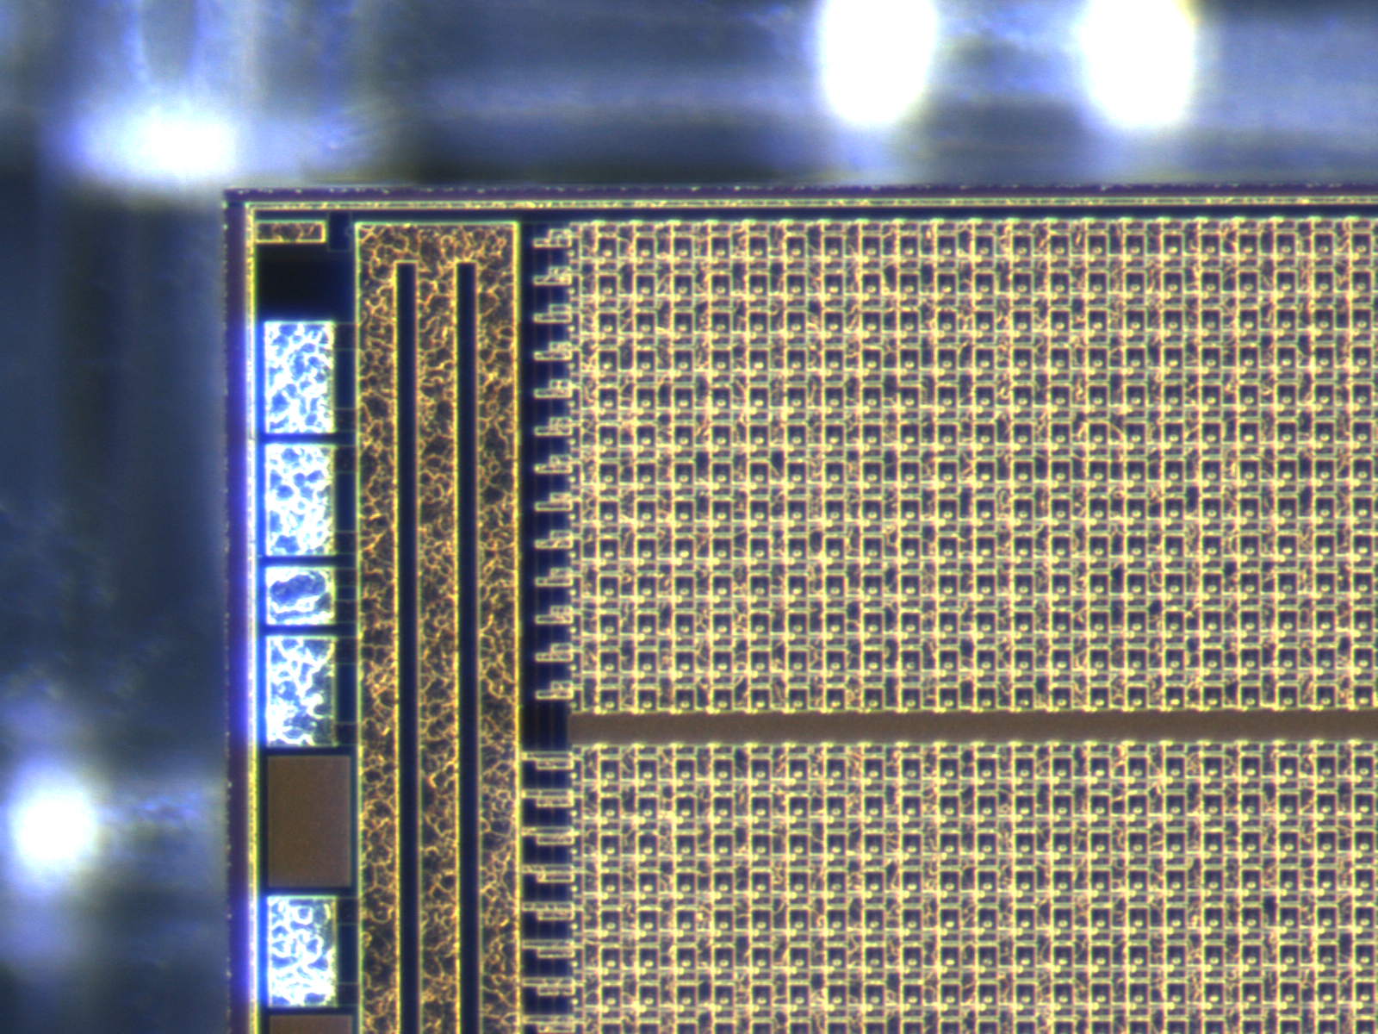
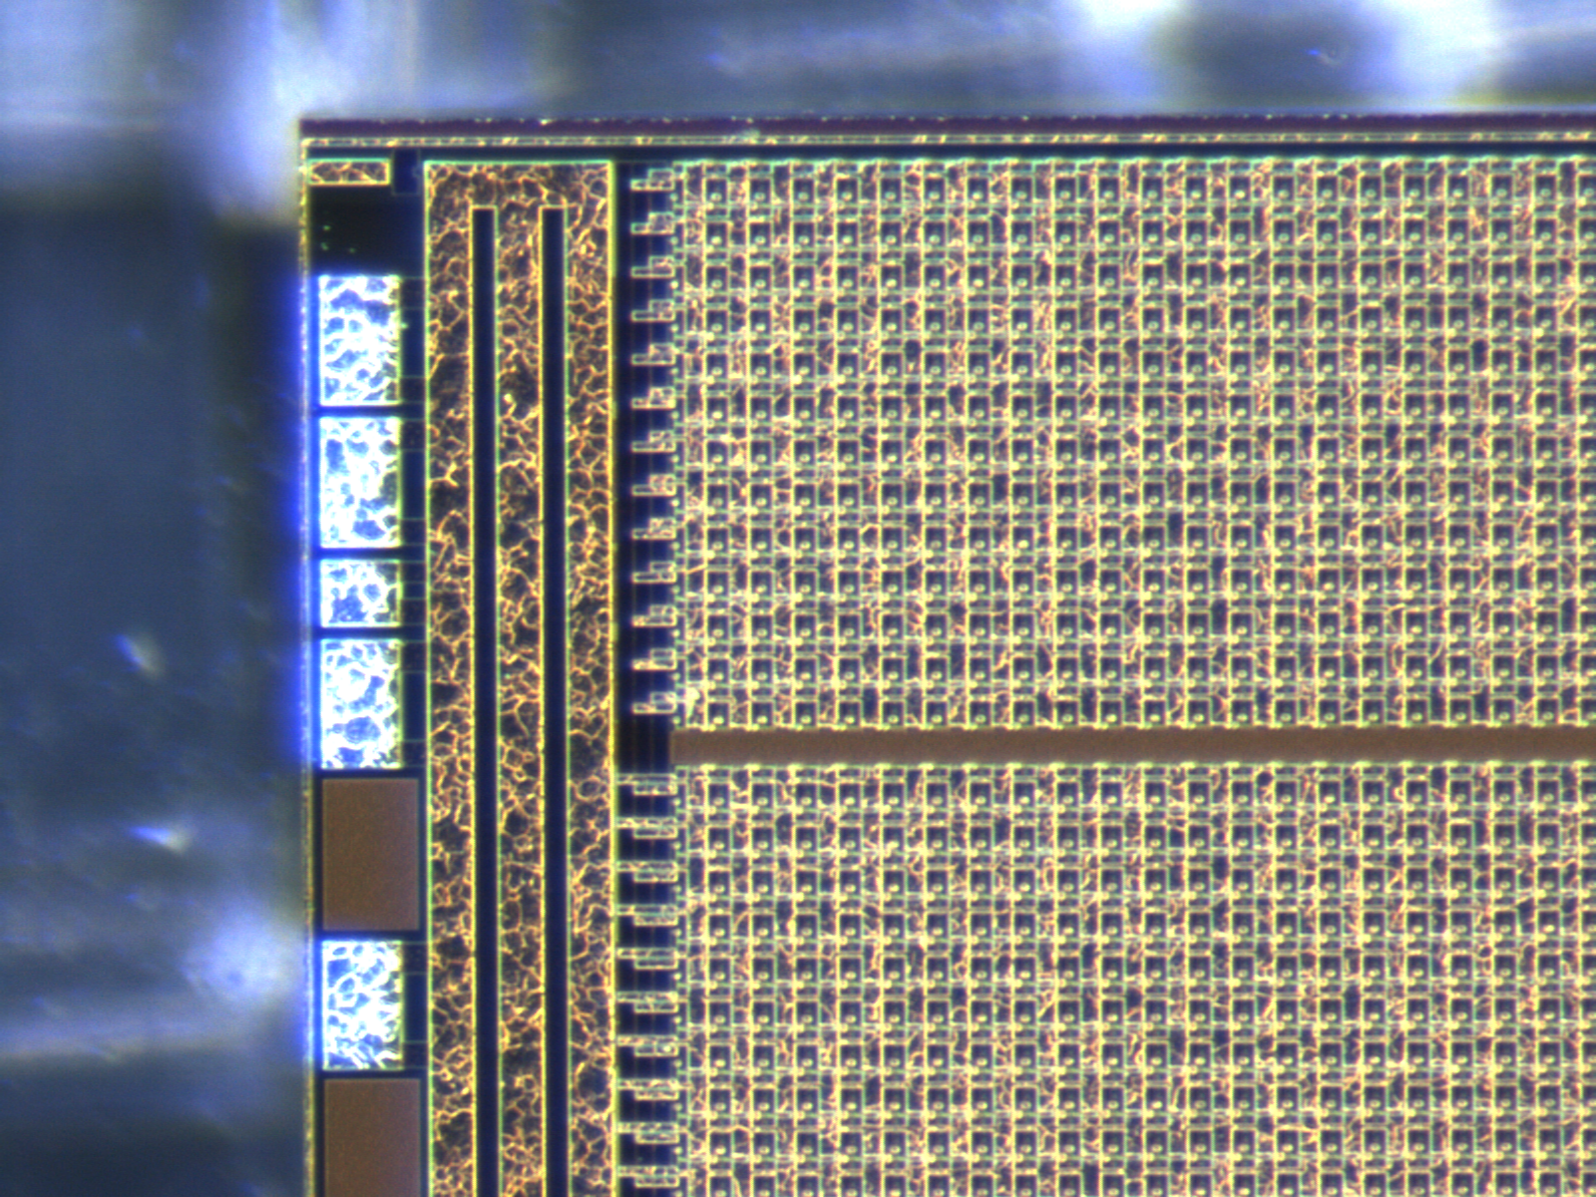
How do you reliably manufacture a mm-scale system?
Most systems are “stair-step” stack of chips
Thin wafers (300 → 150 microns) [now brittle]
Then dice on die-attach film
Then flip onto stack and wirebond
Each step requires some learning…

Slide 26
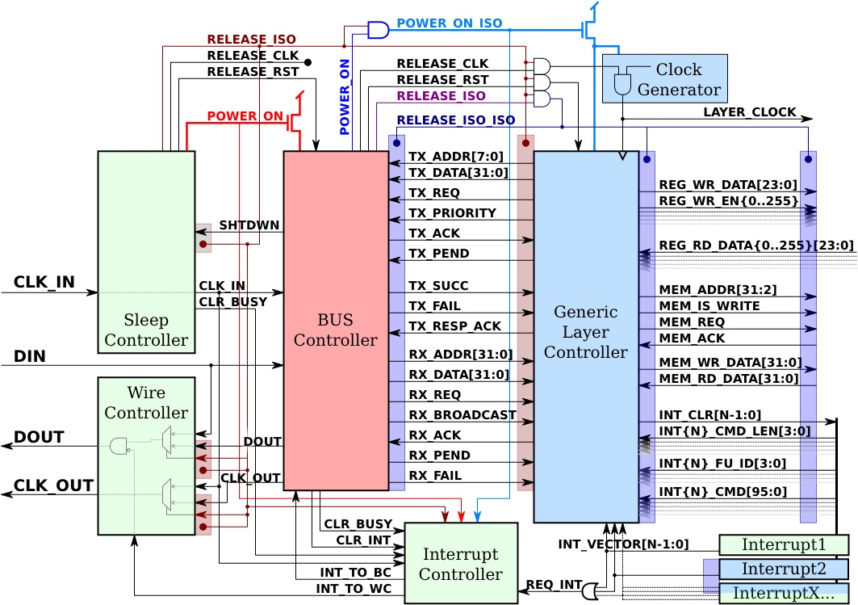
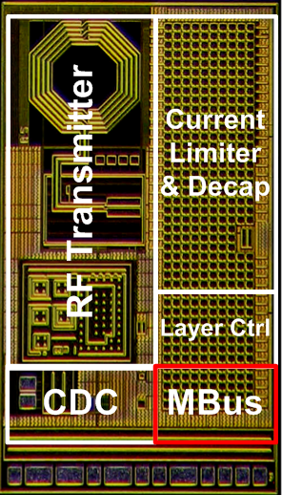
How do you reliably design a mm-scale system?
Conceptually simple: Turn off what you aren’t using
In practice, lots of diagrams that look like this:
Which represents only this corner of the chip

Slide 27
Clock-gating != Power-gating. Need to eliminate static leakage as well
What is this diagram actually showing?
Three hierarchical power domains
Power control signals between domains
Isolation gates between domains
Absence of tool support is biggest challenge
Isolation correctness validated by hand
Effects of isolation simulated “by hand”
Often not at all
Always-on
Controlled
by green
Controlled
by red
Notes:
“Off means off”

Slide 28
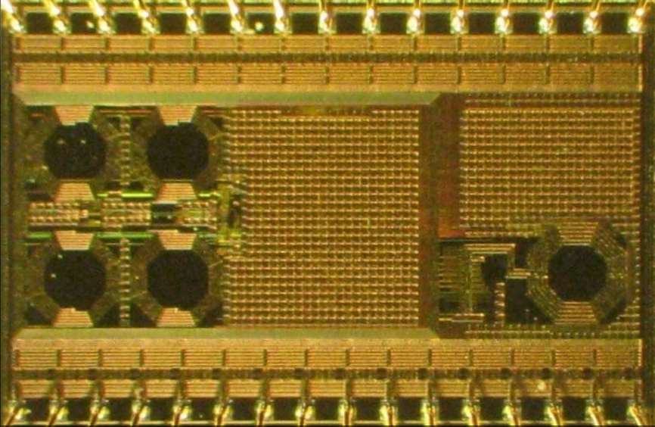
How to bring a new chip into M³ ecosystem?
R1: Dedicated test chip
Lots of I/O, scan, etc
R2: Integrate
Add MBus frontend
Remove most debug pins, expose via registers
R3+: Bugs!
Mohammad Hassan Ghaed, Skylar Skrzyniarz, David Blaauw, Dennis Sylvester, “A 1.6nJ/bit, 19.9µA Peak Current Fully Integrated 2.5mm2 Inductive Transceiver for Volume-Constraned Microsystems,” IEEE Custom Integrated Circuits Conference (CICC), September 2014

Slide 29
There is a natural tension between building working systems and working chips
Need to avoid designing “modular” chips that only work in one system

Slide 30
MPQ: A protocol standard for register and memory access brings SOC efficiency to multi-chip systems
Architectural shift: Remove CPU from steady-state operation
Pre-programmed commands:
ADC: “Every 128 samples, send DMA to radio”
RF: “On DMA CH1 event, send buffer as payload of PKT_TEMPLATE_1”
Atmel’s “sleepwalking”, TI’s μDMA controller
Traditional SOC
SOCs:
Efficiency demands pushing designs back to a monolithic architecture
But the extensible parts aren’t efficient!
CPU can’t program sensor to send packet
CPU
SPI
Radio
ADC
I²C
Sensor

Slide 31
MPQ: A protocol standard for register and memory access brings SOC efficiency to multi-chip systems
Architectural shift: Remove CPU from steady-state operation
Pre-programmed commands:
ADC: “Every 128 samples, send DMA to radio”
RF: “On DMA CH1 event, send buffer as payload of PKT_TEMPLATE_1”
Atmel’s “sleepwalking”, TI’s μDMA controller
Traditional SOC
CPU
SPI
Radio
The issue isn’t the physical layer
ADC
I²C
Sensor

Slide 32
The clean break of a new bus is an opportunity to standardize basic constructs
MPQ – “For those who mind their P’s & Q’s on MBus”
Does not specify device behavior, command interface, etc
Only specifies
What a “register” looks like
What “memory” looks like
And how to read and write registers and memory
This is enough to enable powerful system synthesis constructs
And aligns with how systems are already designed today
MPQ

Slide 33
MBus and MPQ are available today: mbus.io
“MBus Compatible”
Logo certification
Specification and Verilog available (free forever)
MBus + MPQ: Standard interface for mm-scale components

Slide 34









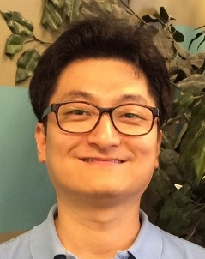
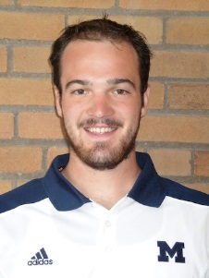


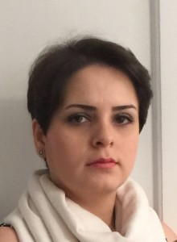
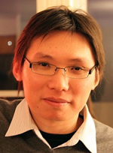









It takes a village…
Mingoo Seok
Scott Hanson
Yu-Shiang Lin
ZhiYoong Foo
Daeyeon Kim
Yoonmyung Lee
Nurrachman Liu
Dennis Sylvester
Suyoung Bang
Ryan Rogel
Hyeongseok Kim
David Blaauw
Gregory Chen
Razi-ul Haque
Michael Wieckowski
Yejoong Kim
Gyouho Kim
Prabal Dutta
Inhee Lee
Pat Pannuto
Jonathan Brown
David Wentzloff
Elnaz Ansari
Ye-Sheng Kuo
Benjamin Kempke
Wanyeong Jung
Yen-Po Chen
Seokhyeon Jeong
Kuo-Ken Huang
Ronald Dreslinski
Dongmin Yoon
Mohammad
Hassan Ghaed
Myungjoon Choi
2007
2008
2009
2010
2011
2012
2013
2014
2015
Notes:
Phoenix: Mingoo Seok, Scott Hanson, Yu-Shiang Lin, Zhiyoong Foo, Daeyeon Kim, Yoonmyung Lee, Nurrachman Liu, Dennis Sylvester, David Blaauw
IOP: Gregory Chen, Hassan Ghaed, Razi-ul Haque, Michael Wieckowski, Yejoong Kim, Gyouho Kim, David Fick, Daeyeon Kim, Mingoo Seok, Kensall Wise, David Blaauw, Dennis Sylvester
JSSC: Yoonmyung Lee, Suyoung Bang, Inhee Lee, Yejoong Kim, Gyouho Kim, Mohammad Hassan Ghaed, Pat Pannuto, Prabal Dutta, Dennis Sylvester, and David Blaauw
IOT Design Space: David Blaauw, Dennis Sylvester, Prabal Dutta, Yoonmyung Lee, Inhee Lee, Sechang Bang, Yejoong Kim, Gyouho Kim, Pat Pannuto, Ye-Sheng Kuo, Dongmin Yoon, Wanyeong Jung, Zhi Yoong Foo, Yen-Po Chen, Jeong Seok-Hyeon, and Myungjoon Choi
VLSI Imager: Gyouho Kim, Zhi Yoong Foo, Pat Pannuto, Ye-Sheng Kuo, Benjamin Kempke, Mohammad Hassan Ghaed, Suyoung Bang, Inhee Lee, Yejoong Kim, Seokhyeon Jeong, Prabal Dutta, Dennis Sylvester, and David Blaauw
CICC: Ye-Sheng Kuo, Pat Pannuto, Gyouho Kim, Zhi Yoong Foo, Inhee Lee, Benjamin Kempke, Prabal Dutta, David Blaauw, and Yoonmyung Lee
Mbus: Pat Pannuto, Yoonmyung Lee, Ye-Sheng Kuo, ZhiYoong Foo, Benjamin Kempke, Gyouho Kim, Ronald G Dreslinski, David Blaauw, and Prabal Dutta

